Slide 1
TEST-BENCH FOR 4-BIT SUBTRACTOR USING CARRYLOOK AHEAD ADDER(CLA)
Question no.1:- What is Test-Bench? Where it came from?
Answer:- Test-Bench is a workbench and an environment to check the correctness of a model.
The term ‘Test-Bench’ comes from the days where electronics was tested on a bench using various testing equipments such as signal generator, oscilloscopes, logic analyzer, etc. Almost all the functional verification is now performed in virtual world using stimulator.
In our case, we are analysing our model(32-bit subtractor using CLA) with the help of NGspice Stimulator.
Question no.2:- What is NGspice Stimulator?
Answer:- NGspice Stimulator is a open source Spice circuit stimulator.
Questiuon no.3:- SPICE stands for?
Answer:- Stimulation Program With Integrated Circuit Emphasis.

Slide 2
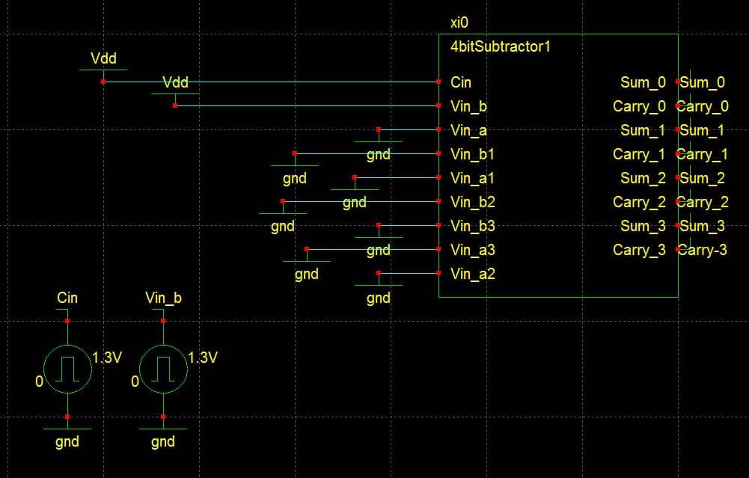
For the testing of 32-bit subtractor using Carry Lookahead Adder we proceed as follows:-
Firstly, we have tested the 4-bit subtractor (shown in,Fig1 & Fig2).
Fig1:- 4-bit subtractor using CLA

Slide 3
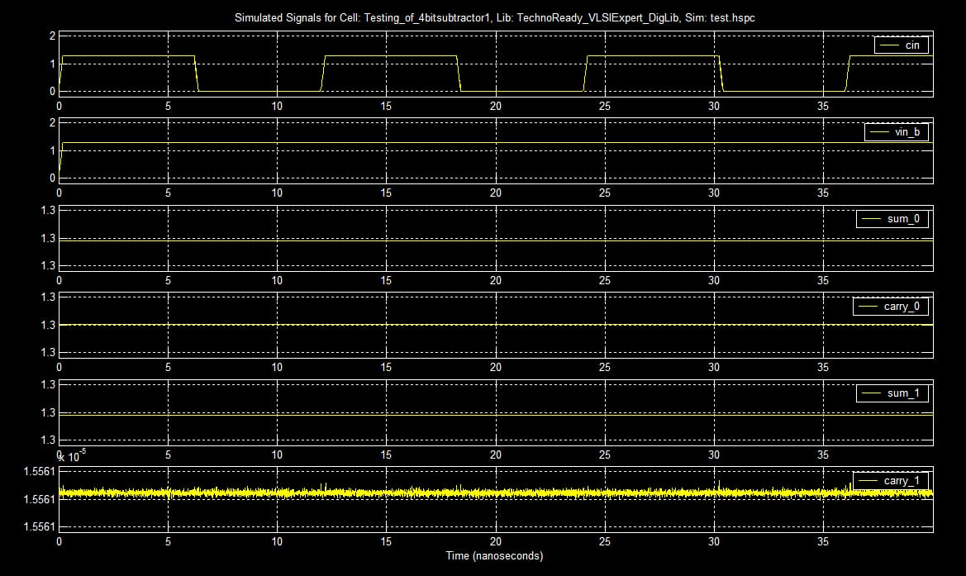
Fig2:- The input and output for 4-bit subtractor test-bench.

Slide 4
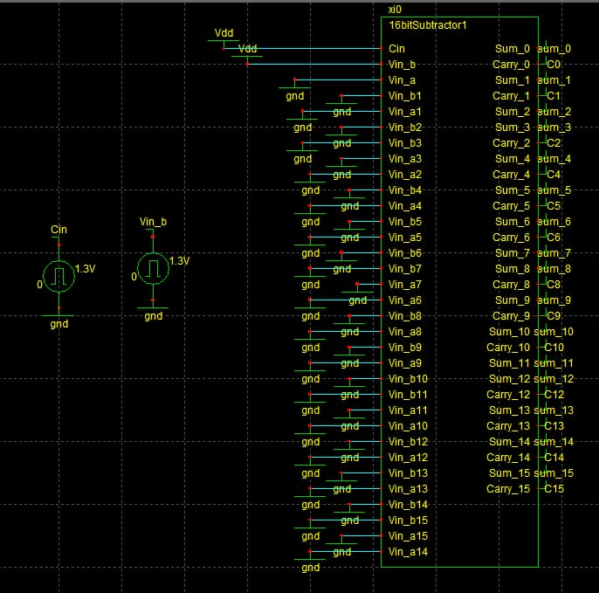
Secondly, we have tested the 16-bit subtractor (shown in, Fig3 & Fig4)
Fig3:- 16-bit subtractor using CLA.

Slide 5
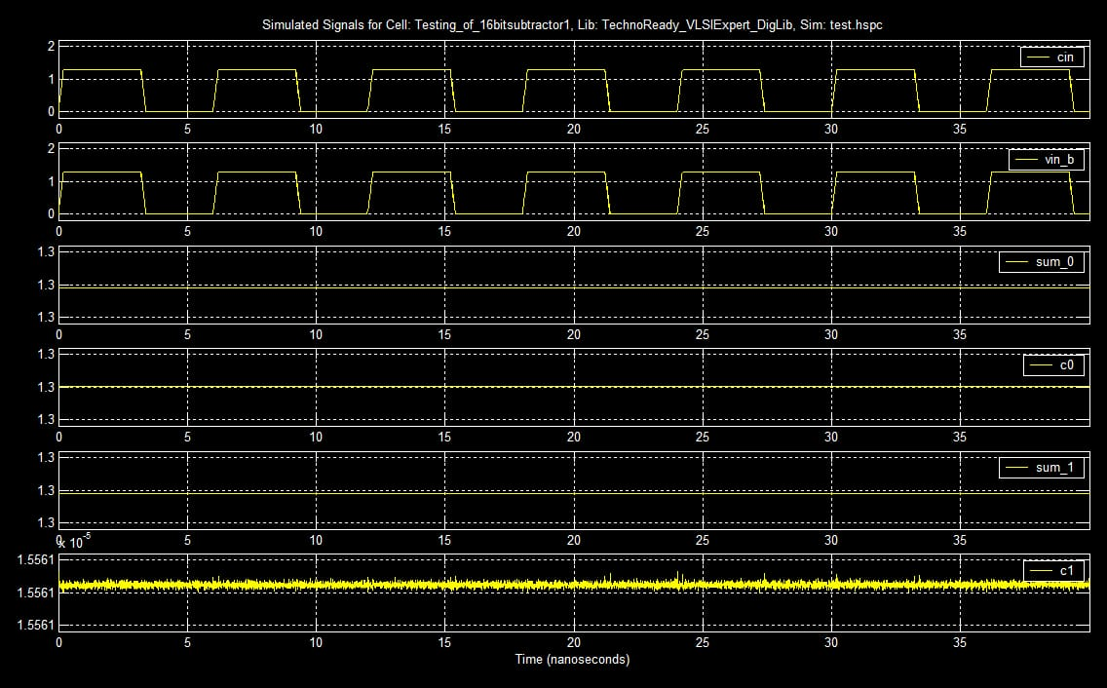
Fig4:- The input and output for the 16-bit subtractor test bench.

Slide 6
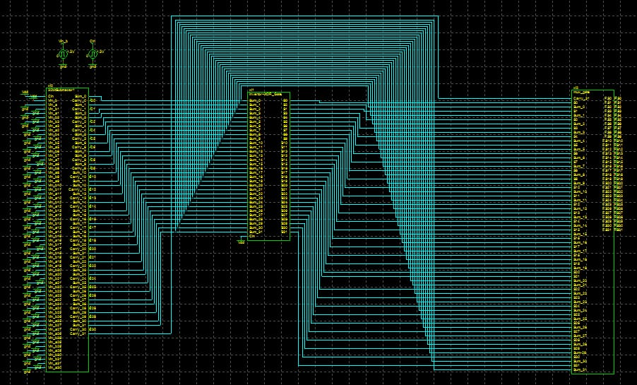
Thirdly, we have tested the 32-bit subtractor (shown in, Fig5 & Fig6)
Fig5:- Test-bench for 32-bit subtractor using CLA.

Slide 7
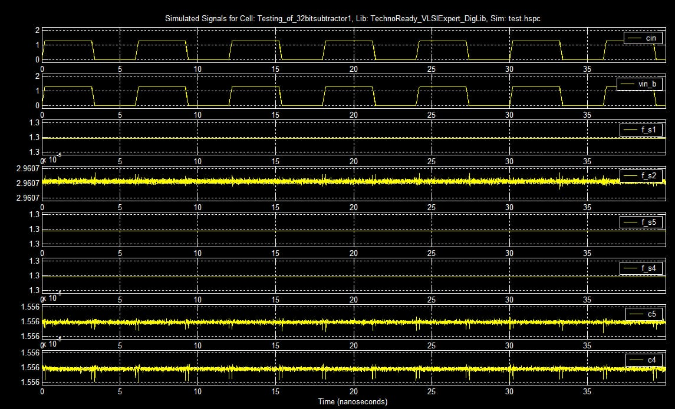
Fig6:- The input and output for the 32-bit subtractor test-bench.

